Slide 1
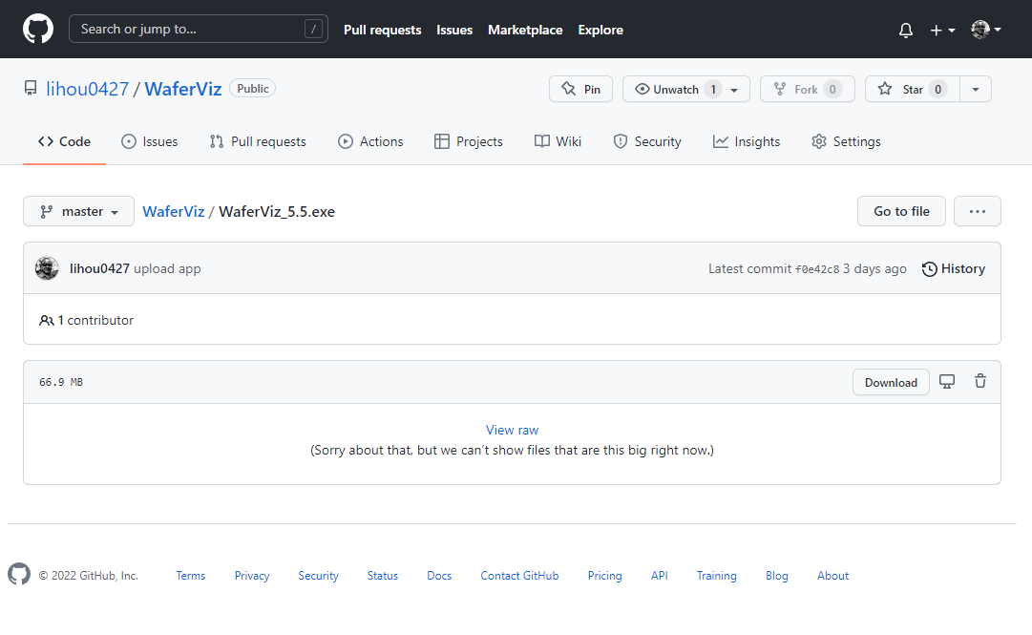
Click “Download”

Slide 2
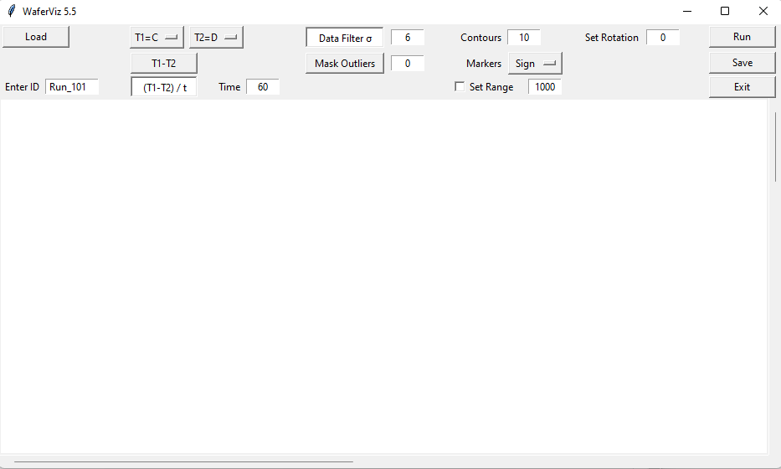

Slide 3
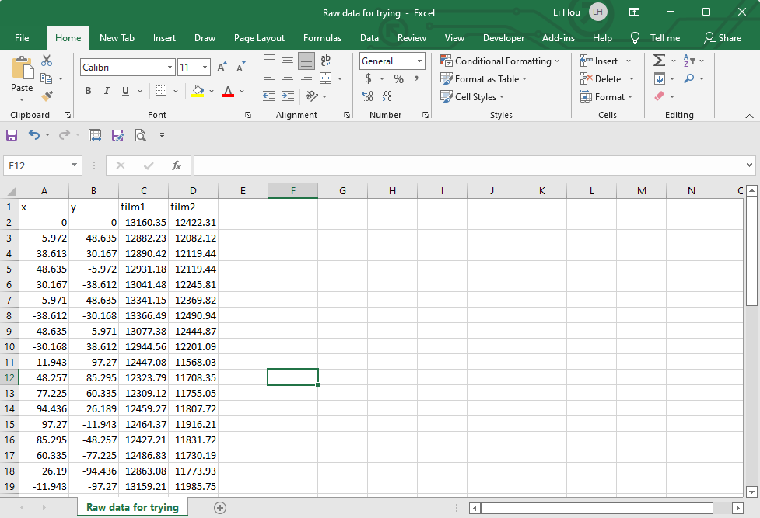
Row1 can be written in anything for notes
Columns starting from A2 and B2 are reserved for x, y coordination
Leave unused columns blank without any elements

